Slide 1
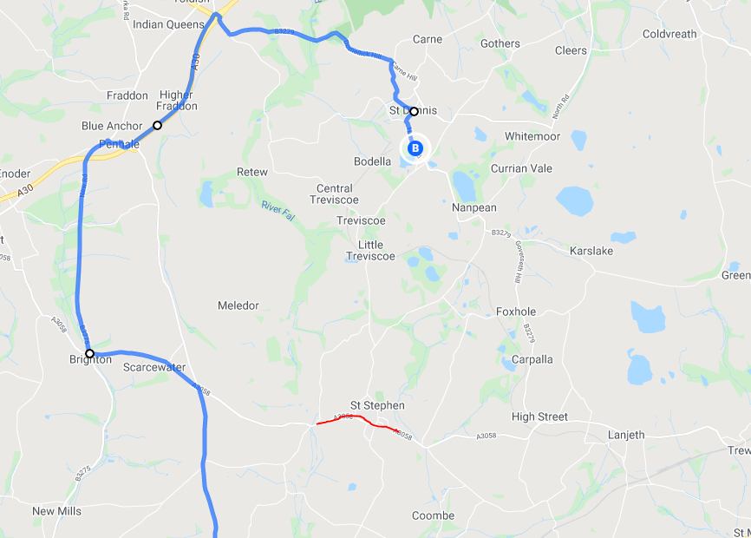
CUSTOMER NOTICE
Roadworks affecting the network
St Stephens Road closure 22
On Friday 29th October 2021 7:30- 18:00
The road through St Stephens will be closed to all traffic. Bus service 22 from Truro will go through Grampound road to the cross roads then turn left to Brighton cross then right to Fraddon. Buses will then join the A30 to St Dennis and resume normal route to St Austell. Bus service 22 from St Austell will get to St Dennis and head to Fraddon then Brighton cross resuming route at Grampound Road.
During this closure bus service 22 will be unable to serve St Stephens in total, Treviscoe and little Treviscoe.
We apologise in advance for any disruption and inconvenience caused by these essential works. For further information please contact Go Cornwall Bus on 0808 196 2632

